Slide 1
USG SSO Architecture
Info and abbreviations
Architecture:
High-level view of IDP Proxy
Gluu cluster architecture (4 separate clusters)
Prod, dev
USG IDP Proxy, USO IDP
One SP where F5 APM provides SAML SP
Logout

Slide 2
Key info and abbreviations
University System of Georgia (USG)
26 schools, plus University System Office (us, AKA "USO")
Decentralized
Each campus runs their own IDP, MFA, and directory
We (USO) run USG-wide IDP Proxy
27 IDPs
~200 SPs
We (USO) also run the USO IDP
~20 SPs
Important distinction: USG (26 schools + us) vs. USO (just us)

Slide 3
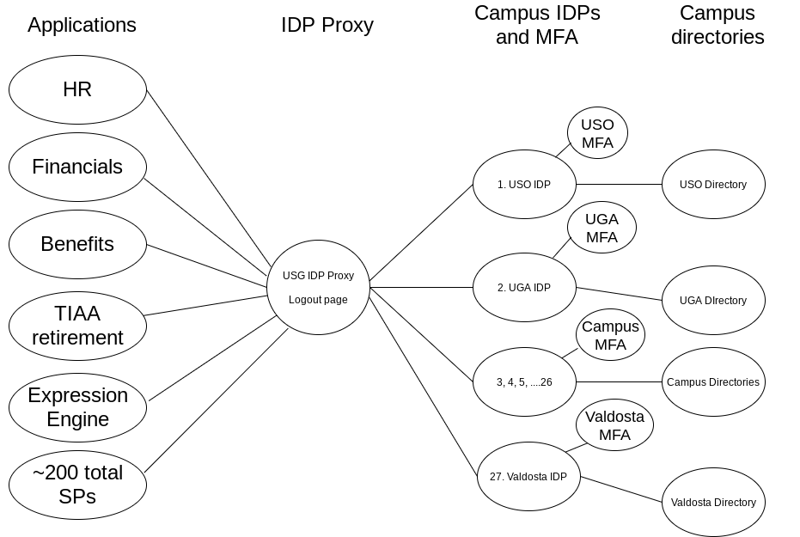
Architecture: USG IDP Proxy

Slide 4
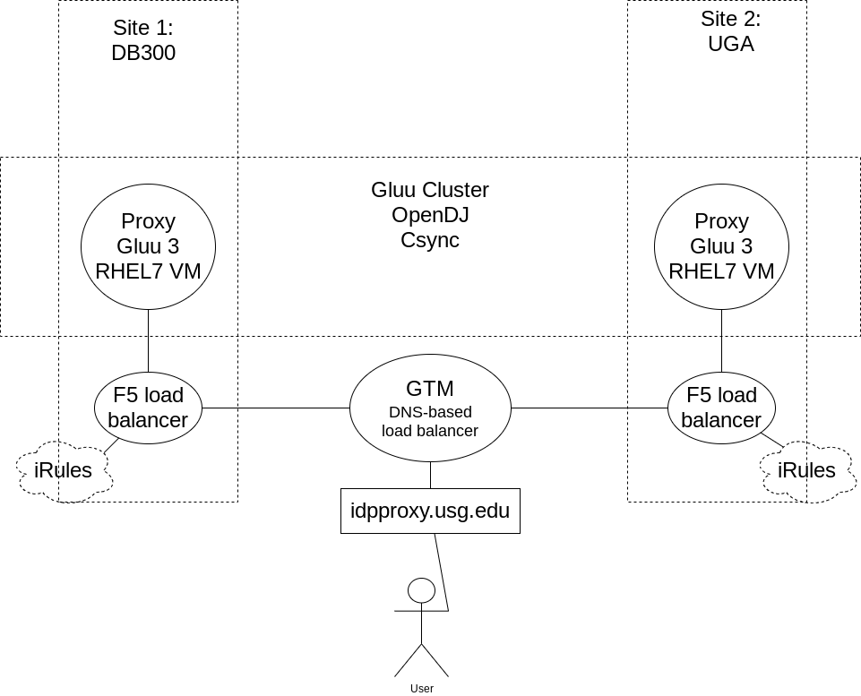
Architecture: Gluu clusters
Same architecture for USO IDP (idp.usg.edu)

Slide 5
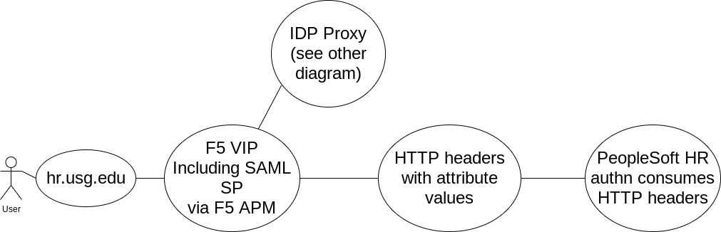
Architecture: One SP using F5 as SP

Slide 6
Asimba and Asimba Script are critical
Asimba provides IDP Proxy
27 Remote IDPs
Many different IDP products (ADFS, Azure, Okta, Quicklaunch, Gluu, etc, etc)
Customized/Pretty IDP picker page—27 school logos
Asimba Script
Captures attributes, stuffs into Gluu LDAP
Custom code developed with Gluu's guidance
Massages some attributes
Inserts extra attributes into Gluu LDAP
Shibboleth "side" of Gluu IDP Proxy install delivers attributes from Gluu LDAP

Slide 7
Logout: Five logouts required
Five logouts
Application (1)
F5 APM session (2) (when applicable)
Gluu IDP Proxy has two components which require logout:
Asimba (3)
Shibboleth (4)
Remote IDP (5)
Logout page
idpproxy.usg.edu/logout/
Front-channel logout page, uses iframes—based on Gluu's 2015 recommendation
Covers all 5 bases listed above
WIP tweaking to redirect to Remote IDP logout page as final step
Because web security is evolving

